Slide 1
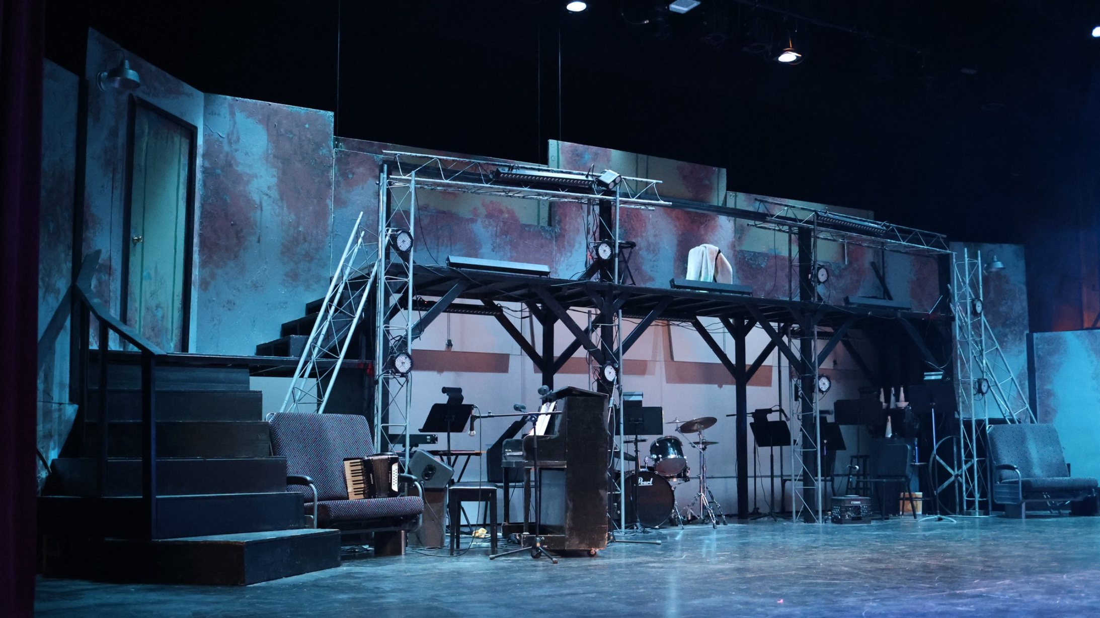
Booster Club Budget Financial Report
Notes:
---
This presentation provides a detailed review of the West Anchorage High School Booster Club's financial performance for the 2024-25 fiscal year and outlines the budget planning for the upcoming 2025-26 year. We will examine income, expenditures, and strategies to ensure financial sustainability.

Slide 2

Topics:
Booster Club Finances Overview
2024/25 Season Report
2025/26 Budget Plan
Notes:
---
We will first review the Booster Club's 2024-25 budget report, including income sources, expenditures, and financial trends. Then, we will discuss the 2025-26 budget planning with projected income, proposed spending, new initiatives, and strategies for growth.
Image source: Microsoft 365 content library

Slide 3

Financial Policies
Governing Documents
    Booster Club By Laws
    Financial Procedures Guide
Key Roles
    Sponsor Teacher/Director
    Student Treasure
    Booster Treasure
Financial Tracking
    QuickBooks
    Paper Binders
    Monthly Reconciliation
Notes:
---
An analysis of the financial data reveals notable trends such as changes in fundraising success and expenditure patterns. This insight helps identify strengths and areas for improvement moving forward.
Image source: Microsoft 365 content library

Slide 4

Sources of Income
Performance Income
    Ticket Sales
    Concessions
    Flowers
Fundraising Events
    “Can You Hear Me” Campaign
    Auction items ( HadesTown Train Seats)
    STAGE Days
    Donations
Grants
    West Alumni Association
    PTSA
Notes:
---
The Booster Club's income for 2024-25 was generated through multiple fundraising activities including events, donations, and sponsorships. This slide highlights the key income streams and the effectiveness of fundraising efforts.
Image source: Microsoft 365 content library

Slide 5
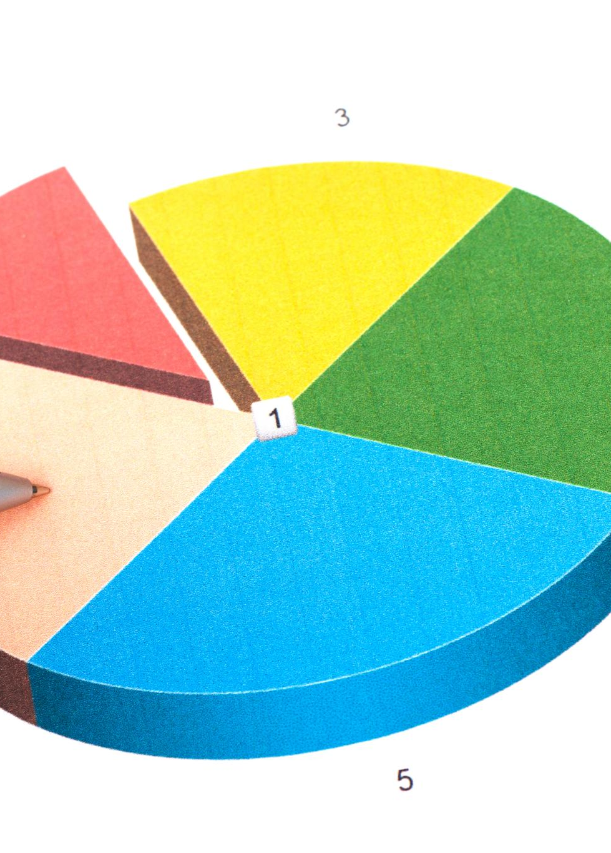
Breakdown of Expenditures
Performance Expenses
    Show Licensing
    Script/Music
    Set
    Front of House
Fundraiser Expenses
    STAGE Costs
    Fundraising Costs
Miscellaneous
    Student Educational Activities
    Booster Club Administration
    Student Scholarships
Lighting
Sound
Props
Costumes
Notes:
---
Expenditures during 2024-25 were allocated to support various school programs and events. This slide provides a detailed look at how funds were distributed across different categories and initiatives.
Image source: Microsoft 365 content library

Slide 6

2024/25 Season Report
Notes:
---
For the 2025-26 fiscal year, the Booster Club has set fundraising goals based on prior performance and new opportunities. This slide outlines expected income sources and targets for successful fundraising campaigns.
Image source: Microsoft 365 content library

Slide 7

2025/26 Season Budget
Notes:
---
To ensure ongoing financial health, the Booster Club will implement strategies focusing on expanding fundraising efforts, optimizing expenditures, and fostering community partnerships. This slide highlights key approaches for sustainable growth.
Image source: Microsoft 365 content library

Slide 8
2025/26 Season Budget
Notes:
---
To ensure ongoing financial health, the Booster Club will implement strategies focusing on expanding fundraising efforts, optimizing expenditures, and fostering community partnerships. This slide highlights key approaches for sustainable growth.
Image source: Microsoft 365 content library

Slide 9
2025/26 Season Budget
Notes:
---
To ensure ongoing financial health, the Booster Club will implement strategies focusing on expanding fundraising efforts, optimizing expenditures, and fostering community partnerships. This slide highlights key approaches for sustainable growth.
Image source: Microsoft 365 content library

Slide 10
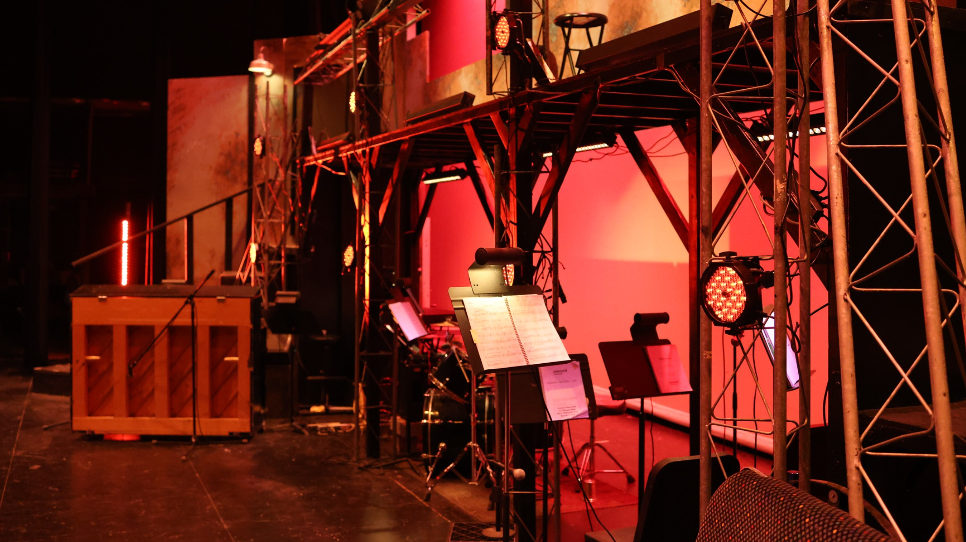
Questions?
Notes:
---
This presentation provides a detailed review of the West Anchorage High School Booster Club's financial performance for the 2024-25 fiscal year and outlines the budget planning for the upcoming 2025-26 year. We will examine income, expenditures, and strategies to ensure financial sustainability.

